Slide 1
FISCAL NOTE PREPARATION
Presented by
Office of Budget & Program Planning
budget.mt.gov/Fiscal-Notes

Slide 2
What is a fiscal note?
Fiscal notes are required on all bills reported out of committee that have an effect on revenues, expenditures, or fiscal liability of the state, a county, or a municipality.
(5-4-201-210, MCA)

Slide 3
What is the total processing time?
Statutory 6-day processing time
Day 1 – presiding officer sends request and
OBPP contacts agencies
Days 2 – 4 agencies draft fiscal note & send to OBPP
Days 4 – 5 OBPP analyst reviews and edits
Day 6 – budget director signs and transmits
to originating house
24 hours for sponsor review

Slide 4
What if the sponsor disagrees with the fiscal note?
Disagree and not sign
Meet with the OBPP analyst and/or the agency clarify and try to have the note revised.
Submit a “Sponsor’s Rebuttal to Fiscal Note” with Legislative Fiscal Division staff which will be printed and distributed with the official fiscal note.

Slide 5
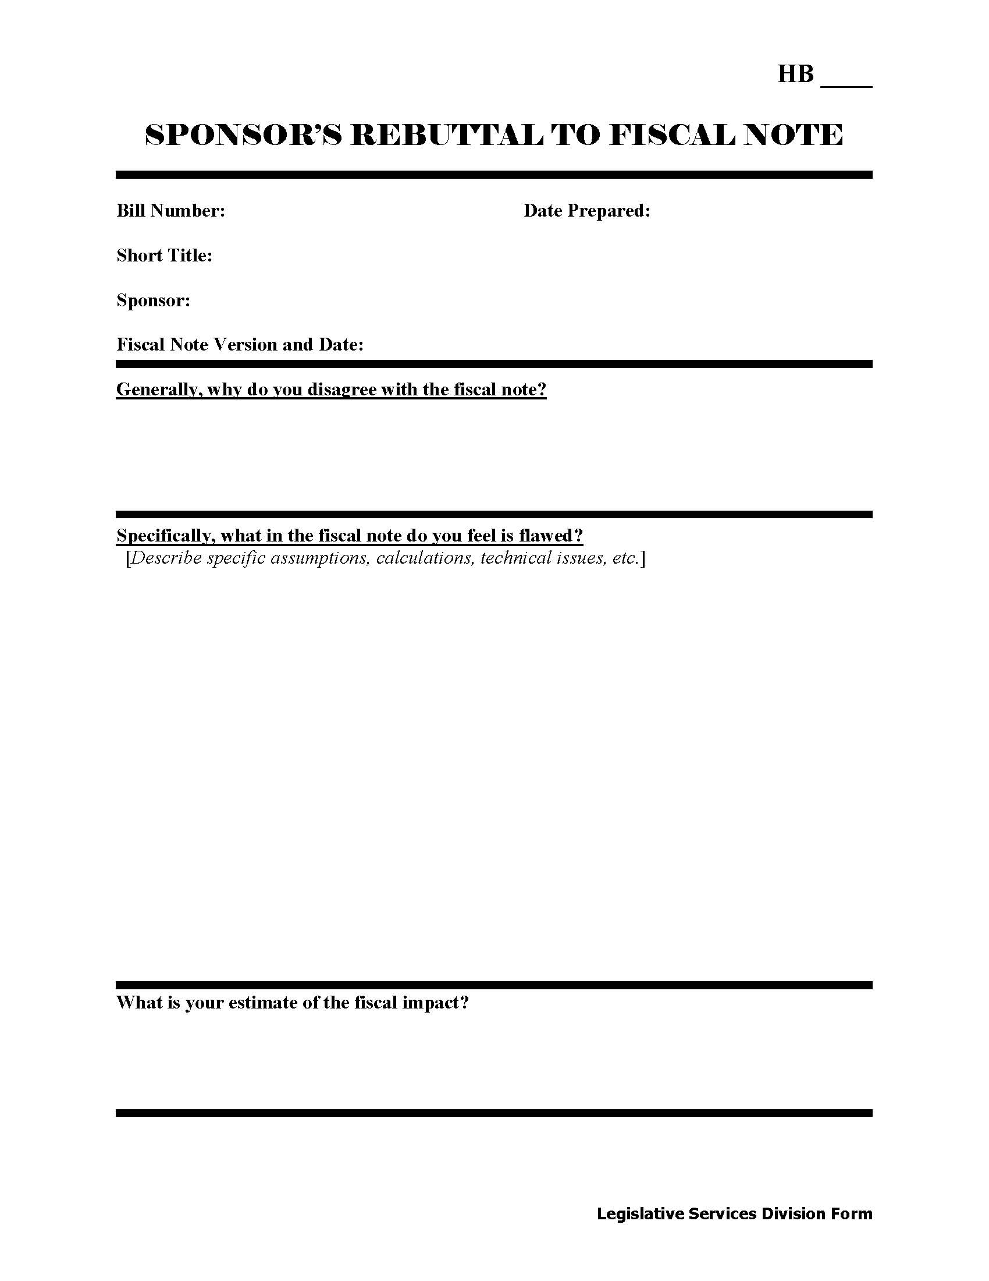

Slide 6
Who requests fiscal notes?
President of the Senate
Speaker of the House

Slide 7
Who determines the need for a fiscal note?
The following may notify the presiding officer that a fiscal note is needed:
Legislative Services Division (LSD)
Standing Committee
Sponsor
Majority of members in the house in which a bill is being considered
Agency may advise the budget office or chair of the committee

Slide 8
Preparing Fiscal Notes

Slide 9
Agencies are notified.
Primary contact for the agency is notified.
Secondary contact is notified, if the primary is unavailable.
Confirmation of request received is required.
Requests after 5:00 PM still count as day 1.
All agencies must respond to the request.

Slide 10
Read the bill
This is the most important step.
Read, reread, and discuss with others until the bill is absolutely clear.
Bills are available on LAWS.
Check the version of the bill to be sure you prepare a fiscal note for the version requested.

Slide 11
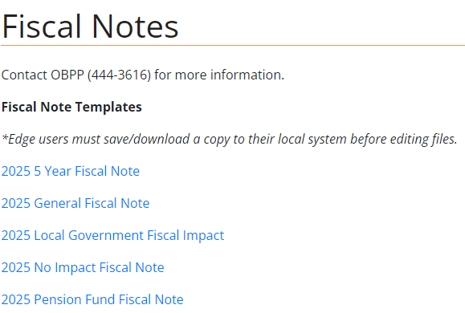
Access the fiscal note template
Budget.mt.gov/Fiscal-Notes
Edge users must save/download a copy to their local system before editing files.

Slide 12
Access the fiscal note template
Select bill, title and sponsor will auto fill.
Select the status.
Select appropriate check boxes.

Slide 13
Fiscal note naming convention
Senate Bills – Sxxxxaaaa.vv
House Bills – Hxxxxaaaa.vv
x = bill number
a = agency number
v = version on bill in top right corner
Add “r” for revised and “dr” for dedicated revenue
H00443501.01

Slide 14
Fiscal Analysis
Assumptions:
State the facts and only the facts
Short concise sentences
Use the Executive Budget to begin adjustments
Separate each assumption as you calculate the fiscal impact
Structure assumptions to follow steps of preparation

Slide 15
Fiscal Analysis (continued)
Assumptions (continued)
Note where the numbers came from
Document source of assumptions
If bill imposes a new requirement - cite workload measures that will be used to determine expenditure estimate.

Slide 16
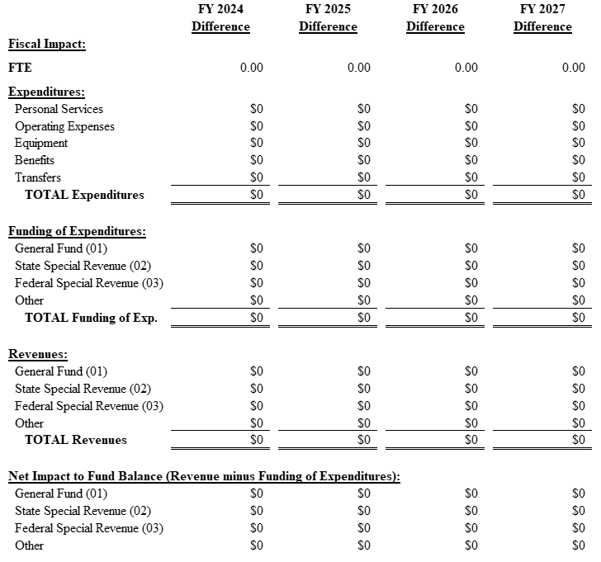
Fiscal Analysis (continued)

Slide 17
Fiscal Analysis (continued)
Fiscal Impact 4 Years
FTE
Expenditures
Show expenditures at first level by program, as presented in HB 2
Use no inflation for FY 2024 and FY 2025 and 1.5% inflation for FY 2026 and FY 2027, if applicable

Slide 18
Fiscal Analysis (continued)
Fiscal Impact (continued)
Fund expenditures by revenue source
Revenues for agency by revenue source
Net Impact to Fund Balance
Show estimated impact by funding source
A positive number will indicate an increase in the fund balance while a negative is a decrease

Slide 19
Fiscal Analysis (continued)
Keep all worksheets and supporting data
Why? – Consistency (between FNs)
OBPP or a Legislator may want to see them
Agency’s current use or for future reference
Similar proposals

Slide 20
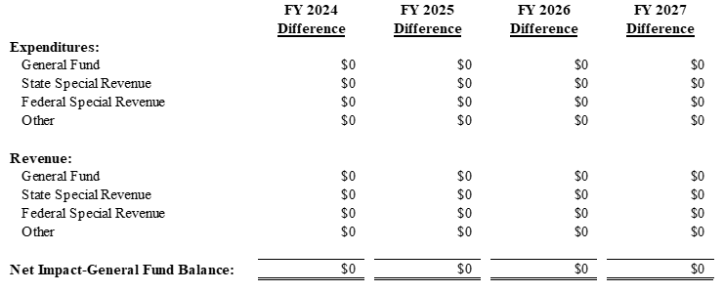
Fiscal Summary – front page
Combines expenditures and revenues by source and states the net impact on the general fund balance for all programs and/or agencies.

Slide 21
Local Government
Explain the fiscal impact on local governments.
Significant impact – write short rationale.
Include defendable estimates, if possible.

Slide 22
Local Government (continued)
If the impact is substantial and the bill does not provide a specific means to finance the requirements, include the following statement:
“This bill may require local governments to spend additional sums for which no specific means of financing are provided. Section 1-2-114, MCA, provides that bills which have such an impact may not be introduced.”
(In other words, it can’t be acted upon in committee until this issue has been resolved.)

Slide 23
Long-term impact
Complete this section ONLY when the fiscal impact is distinctly different beyond the 2027 biennium.
Examples: phased-in revenue or expenditures or sunset

Slide 24
Long-term impact (continued)
If a dollar estimate cannot be provided make a statement telling why.
Long-term effects that are not ordinarily anticipated should be mentioned in the fiscal note and quantified.

Slide 25
Technical Notes
Point out defects of the bill.
Examples:
revenue intended for an agency with no approp
conflicts with unamended statutes
undefined terms, etc.

Slide 26
Dedicated Revenue
“Dedicated Revenue Template 2025”
17-1-507, MCA
This serves as an analysis of the proposed account by answering a series of questions required by law.

Slide 27
Statutory Appropriation
“Statutory Appropriation Template 2025”
17-1-508(2), MCA
This serves as an analysis of the proposed funding by answering a series of questions required by law.
This will be the final assumption of your fiscal note.

Slide 28
Agency completed fiscal note
What to do when agency has completed the fiscal note:
Save fiscal note to the
Guest Directory/SESSION/agency folder
Notify OBPP when completed
JNevins@mt.gov

Slide 29
Amended Fiscal Notes
NEW this session PLEASE
Start with the Word version of the final OBPP fiscal note:
Guest Directory/SESSION/Fiscal Notes – Word Version
Highlight where you have made changes to the fiscal note.

Slide 30
Questions?
Contact the fiscal note coordinator
Jeanne Nevins (jnevins@mt.gov or 444-3616)
OR
your assigned OBPP budget analyst
OR
Nancy Hall (nhall@mt.gov or 444-4899)

